Slide 1

2013 AmeriCorps*Texas
All-Grantee Meeting
April 4-5, 2013

Slide 2

Welcome + Intros
Welcome!

Slide 3
Welcome + Intros
What to expect at All-Grantee Meeting
Goals + Objectives
    Share best practices and challenges
    Reflect on the year-to-date
    Provide important program/fiscal/policy updates and guidance
    Build the AmeriCorps*Texas network

Slide 4
Welcome + Intros
Agenda – Day 1
  Updates from the Field
  Panel Presentations: Disaster or Financial Management
  Lunch (on your own)
  Breakout Sessions: Disability Inclusion or Program Income, Fidelity Bonds, and Compliance Synergy
  Snack break
  Breakout Sessions:
    Program: APR Dos and Don’ts; Branding and Visibility; PM/Data Quality Panel
    Fiscal: OMB Super Circular & Affinity Groups
  Wrap-up
  Reception / Fashion Show
  Dinner on Rainey Street (optional)

Slide 5
Welcome + Intros
Agenda – Day 2
  CEO / CNCS State Director Welcome
  Civic Reflection
  Break
  Understanding AmeriCorps Evaluation Requirements
  Texas Connector Demonstration
  Lunch (on your own)
  National Service Criminal History Check Town Hall
  Break
  Test Your AmeriCorps Knowledge: Jeopardy!
  Close/wrap-up (3:30)

Slide 6

Welcome + Intros
Housekeeping
Notes:
Restrooms down the hall
Post-its – Parking Lot, Restaurant Recommendations
Social media contest and hash tag/ photo release forms

Slide 7

Welcome + Intros
Inventory – who’s in the room?
  AmeriCorps*Texas Programs
  New Planning Grantees
  National Directs
  <5 years AmeriCorps experience
  5+ years AmeriCorps experience
  AmeriCorps Alums
Notes:
Post-its
Restrooms
Meals
Social media / photo release forms

Slide 8
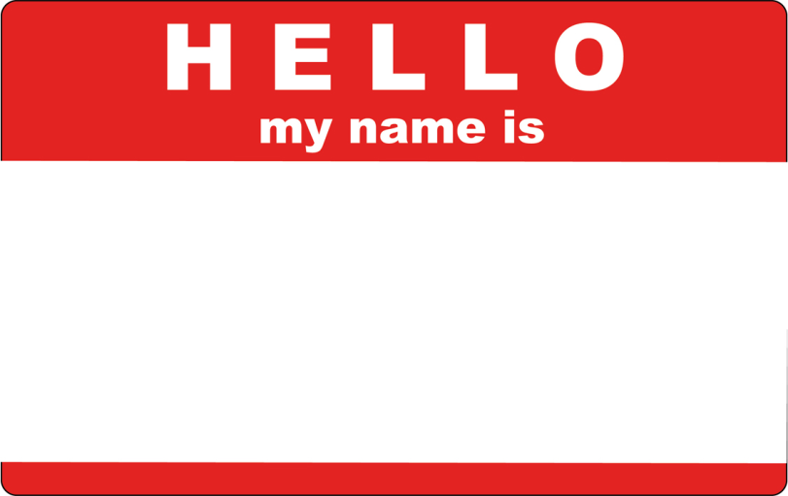
Welcome + Intros
Introductions
  Name and title
  Organization
  A word or phrase that you would use to describe this program year

Slide 9
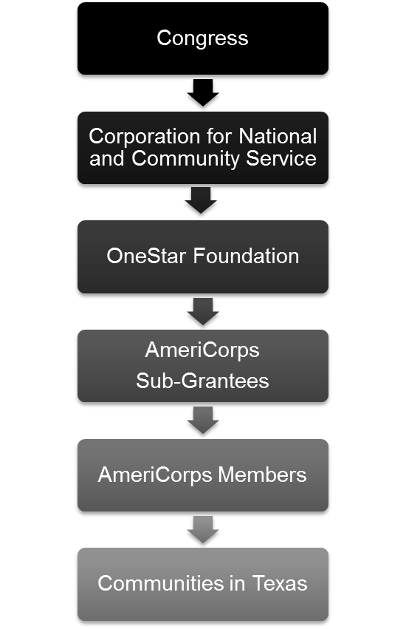




Updates from the Field
News from D.C.
  CNCS Staffing Changes
  New National Service Partnerships
    Department of Ed – School Turnaround
  FY13 Federal Budget / Sequestration
  America’s Service Commissions
  Mayors Day of Recognition – April 9
  Cluster Trainings – SW Cluster – July 24-26 (Denver)
  National Conference & Awards - June 19-21 (DC)
Notes:
New CNCS CEO Wendy Spencer
New CNCS Director of AmeriCorps Bill Basl
New CNCS Director of Research and Evaluation Chris Spera
New CNCS Program Officer Tova Pertman
New CNCS TX State Director Terry Gunnell
No more CNCS Training Division

Slide 10

Updates from the Field
News from Texas
  Legislative Session – Jan 28-May 7
  Governor’s Proclamation
  Texas House of Representatives recognition
Notes:
30th Annual Governor’s Volunteer Awards - Online Nomination release:
Deadline will be May 20
2013 award categories:
• Governor's Lonestar Achievement
• First Lady's Rising Star
• Community Leadership
• AmeriCorps*State and National “Getting Things Done”
• Senior Corps Community Impact
• VISTA Capacity Building
Leadership Council
OneStar hosted its first ever spring meeting for the AmeriCorps*Texas Leadership Council Kick-Off from February 25-26, 2013, which brought back together the 20-member elected council from each AmeriCorps program across the state. Members benefited from “Influencing without Authority” training from Leadership Austin, strengths-based leadership curriculum, and a national service panel consisting of CEOs of OneStar, Serve Delaware, and the Corporation for National and Community Service’s Texas State Office. In addition, members spent group project time in their four working groups: AmeriCorps Week, Disability Inclusion, Marketing & Communications, and Veterans & Military Family Outreach. View a video made by our Leadership Council members here!
Texas Connector – now live! 1-week free trials. Feedback always needed. Subscribe now – may be able to use grant funds.
Nonprofit Management Alliance of Texas (NMAT)
Will host a series of discussions featuring David La Piana of La Piana Consulting, national firm dedicated to strengthening nonprofits and foundations. A collaboration between Greenlights for Nonprofit Success, the RGK Center for Philanthropy and Community Service and OneStar is bringing La Piana to Austin for three events on May 6th and 7th. The first is a lecture as part of the Moody Lecture Series at RGK Center on May 6th. May 7th will include a Town Hall Meeting hosted by Greenlights entitled “Aligned for Impact: Perspectives on What Works in Nonprofit Collaborations and Mergers”. The day will culminate with a private session for NMAT members and guests where the role of capacity builders in nonprofit collaborations and mergers will be discussed.
Volunteer Generation Fund (VGF)
Sarah Jane Rehnborg of the RGK Center for Philanthropy and Community Service has been engaged to consult with TAVC regarding its goals for the future and sustainability after the Volunteer Generation Fund grants end in September 2013. Dr. Rehnborg met with TAVC membership on March 1st and was positively received by the group. She will be working with TAVC through September and will publish a report on her findings.

Slide 11




Updates from the Field
News from OneStar
  Leadership Council
  Nonprofit Management Alliance of Texas (NMAT)
  TX Association of Volunteer Centers (TAVC)
  Interagency Coordinating Group (ICG)
  Governor’s Volunteer Awards (GVA) – Sept 11
  Texas Association of Business (TAB)
  Texas Nonprofit Summit (TNS) – Sept 12-13
  Texas Connector
Notes:
30th Annual Governor’s Volunteer Awards - Online Nomination release:
Monday, April 8 with a deadline of May 20
2013 award categories:
• Governor's Lonestar Achievement
• First Lady's Rising Star
• Community Leadership
• AmeriCorps*State and National “Getting Things Done”
• Senior Corps Community Impact
• VISTA Capacity Building
Leadership Council
OneStar hosted its first ever spring meeting for the AmeriCorps*Texas Leadership Council Kick-Off from February 25-26, 2013, which brought back together the 20-member elected council from each AmeriCorps program across the state. Members benefited from “Influencing without Authority” training from Leadership Austin, strengths-based leadership curriculum, and a national service panel consisting of CEOs of OneStar, Serve Delaware, and the Corporation for National and Community Service’s Texas State Office. In addition, members spent group project time in their four working groups: AmeriCorps Week, Disability Inclusion, Marketing & Communications, and Veterans & Military Family Outreach. View a video made by our Leadership Council members here!
Texas Connector – now live! 1-week free trials. Feedback always needed. Subscribe now – may be able to use grant funds.
Nonprofit Management Alliance of Texas (NMAT)
NMAT members completed the second of two “Powered by Pro Bono” sessions with Taproot Foundation on February 27th. Several NMAT members also received one-on-one training on the topic from Taproot. The second opportunity of 2013 is a series of discussions featuring David La Piana of La Piana Consulting, national firm dedicated to strengthening nonprofits and foundations. A collaboration between Greenlights for Nonprofit Success, the RGK Center for Philanthropy and Community Service and OneStar is bringing La Piana to Austin for three events on May 6th and 7th. NMAT members are encouraged to attend all three. The first is a lecture as part of the Moody Lecture Series at RGK Center on May 6th. May 7th will include a Town Hall Meeting hosted by Greenlights entitled “Aligned for Impact: Perspectives on What Works in Nonprofit Collaborations and Mergers”. The day will culminate with a private session for NMAT members and guests where the role of capacity builders in nonprofit collaborations and mergers will be discussed. A third training will be held in conjunction with the Texas Nonprofit Summit. Amy Celep, CEO of Community Wealth Ventures, will lead a discussion on the top ten insights they believe have created transformational change in organizations they have worked with and researched.
Volunteer Generation Fund (VGF)
On January 25, 2013 the Texas Association of Volunteer Centers (TAVC) sponsored a webcast of Sarah Jane Rehnborg’s session at the Texas Volunteer Management Conference. The webcast session, entitled Frameworks for Management, was attended by 50 individuals from across the State of Texas. The first of the regional symposiums focusing on volunteer management was held in Austin with a select group of nonprofit leaders and was a resounding success. Seven more symposiums on volunteer management are scheduled over the coming six months. Sarah Jane Rehnborg of the RGK Center for Philanthropy and Community Service has been engaged to consult with TAVC regarding its goals for the future and sustainability after the Volunteer Generation Fund grants end in September 2013. Dr. Rehnborg met with TAVC membership on March 1st and was positively received by the group. She will be working with TAVC through September and will publish a report on her findings.
With the legislative session in full bloom the ICG is working through its four committees on: 1) populating the OneStar web portal with more opportunities for nonprofits to work with the state; 2) finalizing an online PowerPoint of the Contracting Lifecycle in a way faith- and community-based organization can better understand the state’s processes; and 3) adopting use of Texas Connector within ICG agencies. Several webinars are planned for the Health and Human Services Commission (HHSC) in the early part of April. Then, HHSC leaders will invite their enterprise agencies (DARS, DFPS, DADS, DSHS etc.) to do the same.

Slide 12
Grant Making 2013
Changes from 2012 to 2013
  Notification in mid-June
  Slight modifications to narrative questions/sections
Funding Situation
  Waiting for Formula Allocation to be announced
  Anticipate lower amount from FY12
  Implications
    Few, if any, expansions
    Limited new programs

Slide 13
Grant Making 2013
Grant Making Terms to Remember
  Recompete
    Occurs during/after year three of your AmeriCorps grant.
    Competitively reviewed
    Past performance taken into consideration
  Continuation
    Occurs during years one and three of your grant.
    Non-competitively reviewed
    Past performance taken into consideration

Slide 14


Slide 15
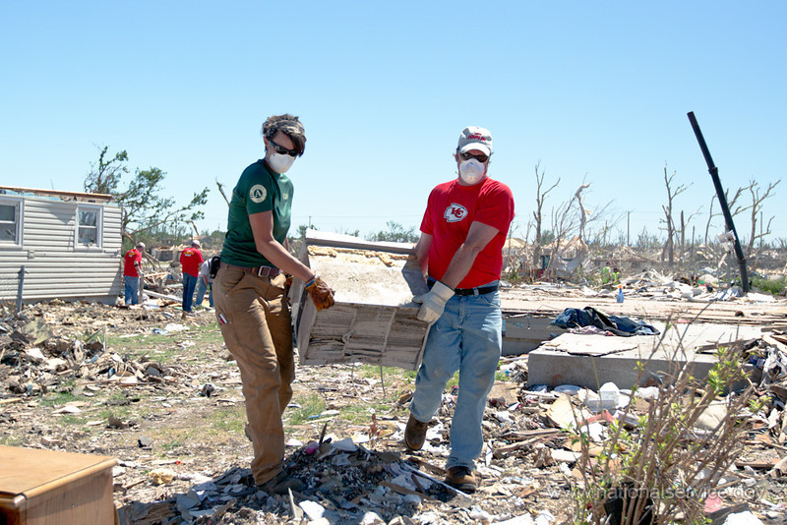
The AmeriCorps Role in Disaster Response and Recovery
Notes:
Fiscal sessions will now begin in Azalea/Bluebonnet
Program session will be in Lantana B/C

Slide 16
Role in Disaster
Background
  History – Katrina, Ike, Bastrop, Sandy
  Role in State Emergency Plan
Why does disaster response
and recovery matter?
  Our communities need us
  Opportunity to demonstrate impact
  We will be called upon
Notes:
OneStar’s Role in State Plan – POC for:
-National Service resources
-Unaffiliated volunteers (portal – VolunteerTX.org)

Slide 17
Role in Disaster
National AmeriCorps Disaster Goals (CNCS)
Disaster Services: Grants will help individuals and communities prepare, respond, recover and mitigate disasters and increase community resiliency. Grant activities will:
o Increase the preparedness of individuals,
o Increase the individuals’ readiness to respond,
o Help individuals recover from disasters; and
o Help individuals mitigate disasters.
Notes:
OneStar’s Role in State Plan – POC for:
-National Service resources
-Unaffiliated volunteers (portal – VolunteerTX.org)

Slide 18
Role in Disaster
Grant Requirements: Past and Present
Past (2012-13):
Members available to be deployed
Present/New (2013-14):
Members available to be deployed
Basic disaster training required of all members
Notes:
OneStar’s Role in State Plan – POC for:
-National Service resources
-Unaffiliated volunteers (portal – VolunteerTX.org)

Slide 19
Role in Disaster
Videos:
Count On Us
National Service Works in Disaster
Notes:
KXAN TxCC feature (3 min): http://www.kxan.com/dpp/news/local/austin/stormy-skies-await-americorps-workers
Count On Us (3 min): http://www.youtube.com/watch?v=QrPQnG8HuEc&feature=youtu.be
National Service Works in Disaster (5 min): http://www.youtube.com/watch?v=AsgiXGKjuuU&list=UU1VuXCdPlovso1vcqi2dMng&index=6

Slide 20
Role in Disaster
Disaster Response Panel
Presenters:
Anna Tangredi, Texas Division of Emergency Management
Chris Sheffield, Texas Conservation Corps
Colin Foltz, Texas Conservation Corps (Member)

Slide 21
Anna Tangredi
Voluntary Agency Liaison (VAL)
Texas Division of Emergency Management

Slide 22
Phases of a Disaster
Disaster
Cycle
Preparedness
Mitigation
Incident
Recovery
Response

Slide 23
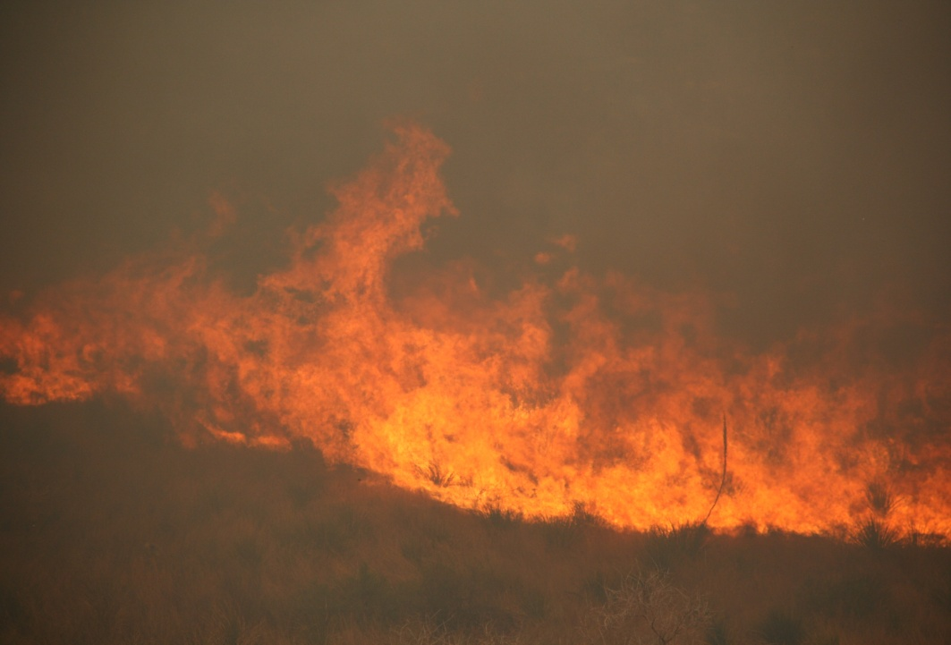
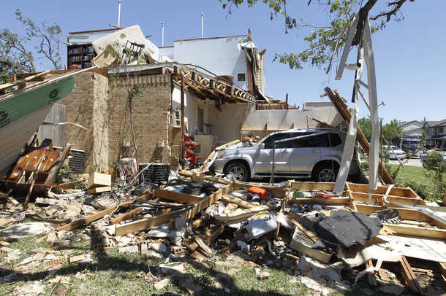
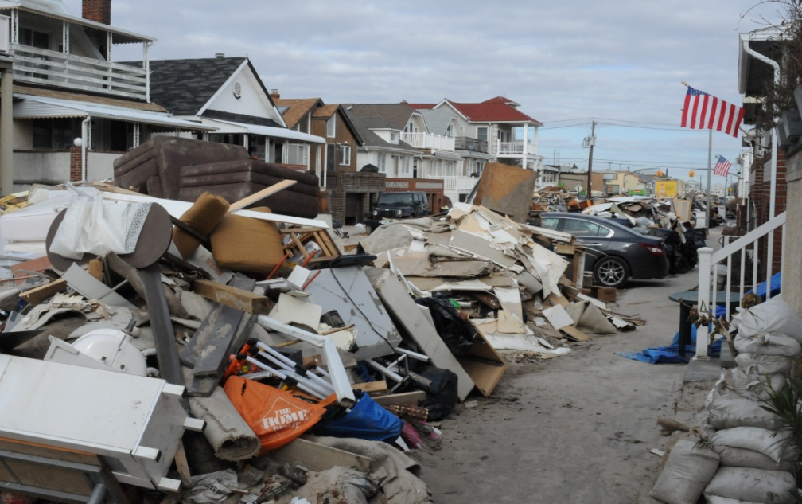
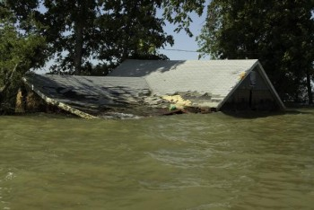
Tornado
Wildfire
Hurricane
Flooding

Slide 24
Role of Government
When the disaster exceeds the local resource capacity the local government turns to the State for assistance, and when that capacity is exceeded, the state turns to the federal government for assistance.
Local Voluntary Organizations Active in Disaster (VOAD) operates in much the same way. The local organizations respond until they no longer have the necessary resources and they then contact their state representative. If the disaster exceeds the state organizations ability to respond, they contact their national organization.

Slide 25
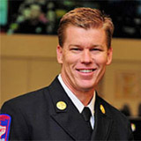
Texas Division of Emergency Management
The Chief of Emergency Management, Chief Nim Kidd, is responsible for all four phases of a disaster in Texas. He is considered an Assistant Chief in the Texas Dept. of Public Safety.
He reports to the Director of DPS and the Governor
Of Texas.

Slide 27
While all disasters are local, the state and federal government are available and will assist.
At some point following the response, the state and federal government will again turn things over to the local government.
Local, State and Federal Government develop plans to respond to disasters.

Slide 28







Slide 29

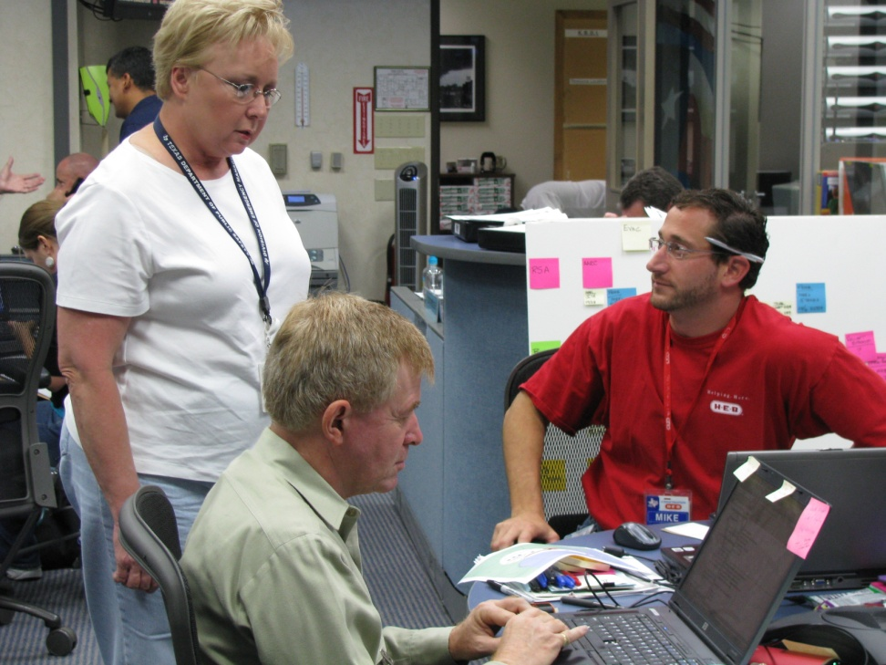
Working in the State Operations Center (SOC)

Slide 30
Voluntary Agency Liaison (VAL) Role
The Voluntary Agency Liaison is responsible for the following:
A conduit between government and voluntary organizations
Advocate for the voluntary organizations
Responsible for Donations Management-unsolicited
Responsible for Volunteer Management-unaffiliated
Responsible for developing VOAD organizations regionally
Responsible for developing and assisting local communities
with forming Long Term Recovery Group following a disaster

Slide 31
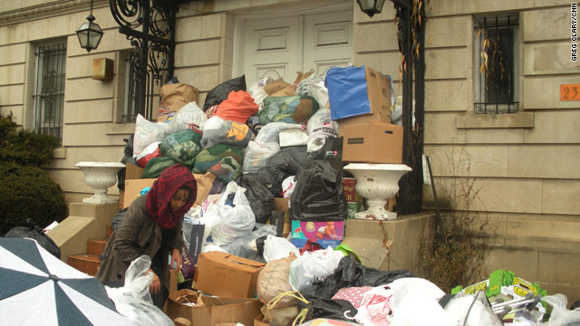
Donations piled at the Haitian Embassy in DC following the 2010 Earthquake
Notes:
Employees could not get in the front door for work

Slide 32
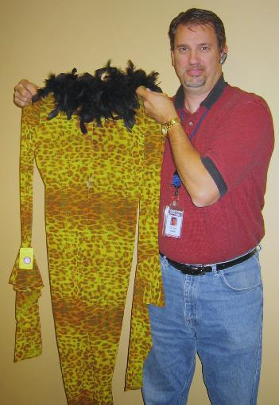
A long sleeve see-through leopard leotard with feather collar

Slide 33
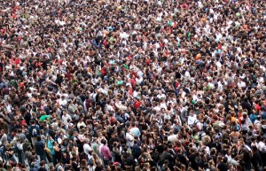
Unaffiliated Volunteers

Slide 34
Role of AmeriCorps in Texas
My Vision
Team Rubicon sets up and manages a Volunteer Reception Center (VRC)
AmeriCorps Members Operate the Volunteer Reception Center (NCCC, TxCC, Disaster Council, or other members trained in spontaneous volunteer management)
TDEM and AmeriCorps help identify a local organization/group to assume responsibility for the Volunteer Reception Center in the long-term

Slide 35
www.preparingtexas.org - to take classes in Texas
www.txdps.state.tx.us - TDEM website
www.txvoad.org - Texas VOAD Organization
Twitter: @disasterlady

Slide 37
Role in Disaster
Chris Sheffield
Program Director
Texas Conservation Corps at American YouthWorks

Slide 38
Texas Conservation Corps Program
American YouthWorks
Charter High School &
Training / Service Programs
Texas Conservation Corps
Service Learning Academy
Charter High School
Casa Verde
Builders
Youth High School Crews
Youth Summer Crews
Conservation Field Crews
Texas Parks and Wildlife
Trails Crews
Internship / Single Placement
AmeriCorps Positions
Emergency Response Crews

Slide 39
Disaster Response Statement of Work
Support activities in the following areas: Shelter; feeding; donations and volunteer management; warehousing; non-hazardous disaster debris removal for elderly, low-income, and special needs populations; tarping; chain saw work (for qualified crews); call centers; volunteer base camp needs assessment; assist with case management; and, long-term recovery committee work.

Slide 40
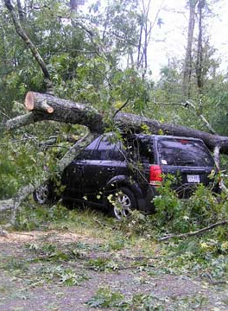
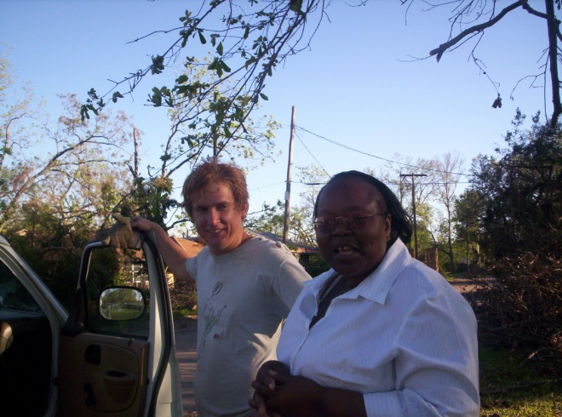
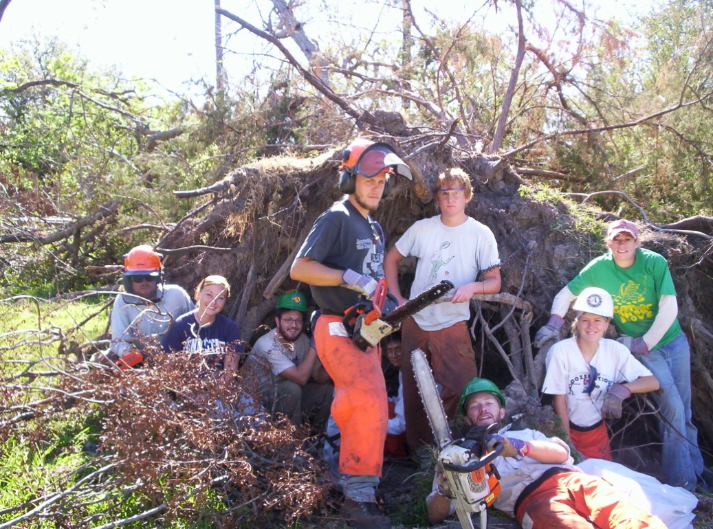
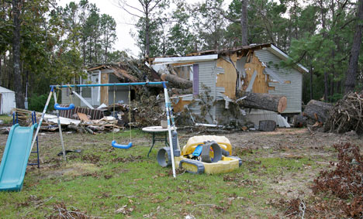
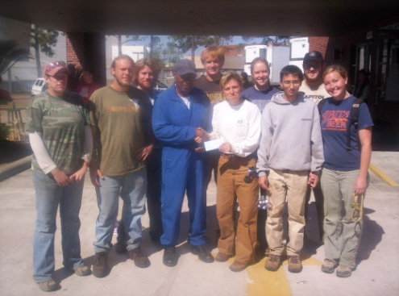
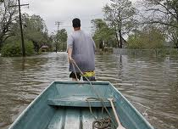
Hurricane Rita, Orange, Texas 2005

Slide 41
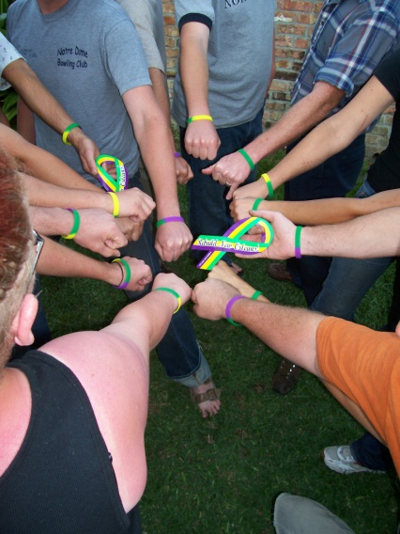
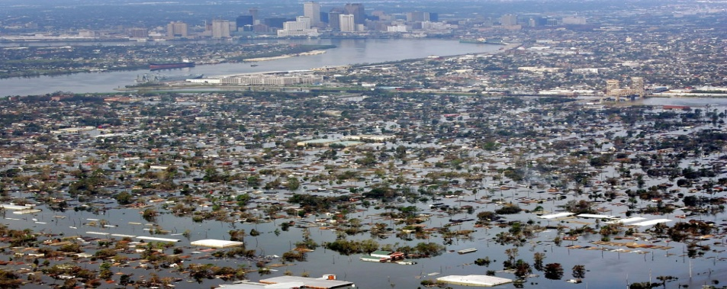
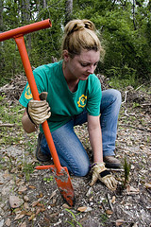
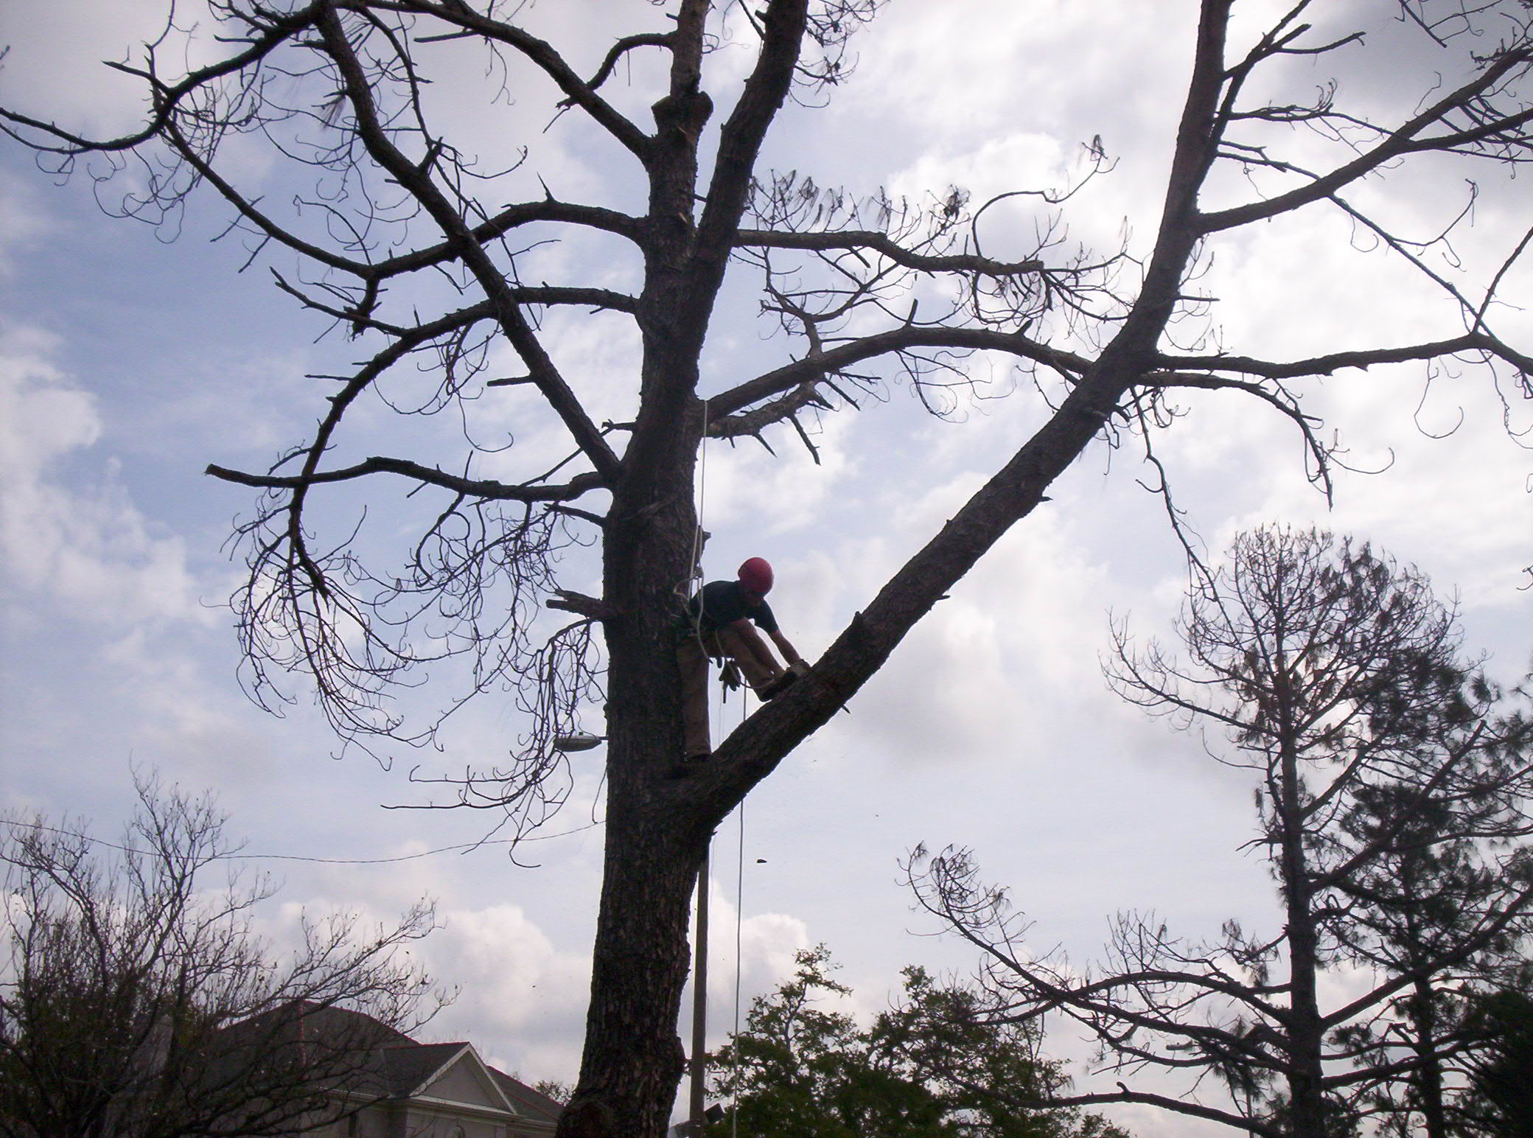
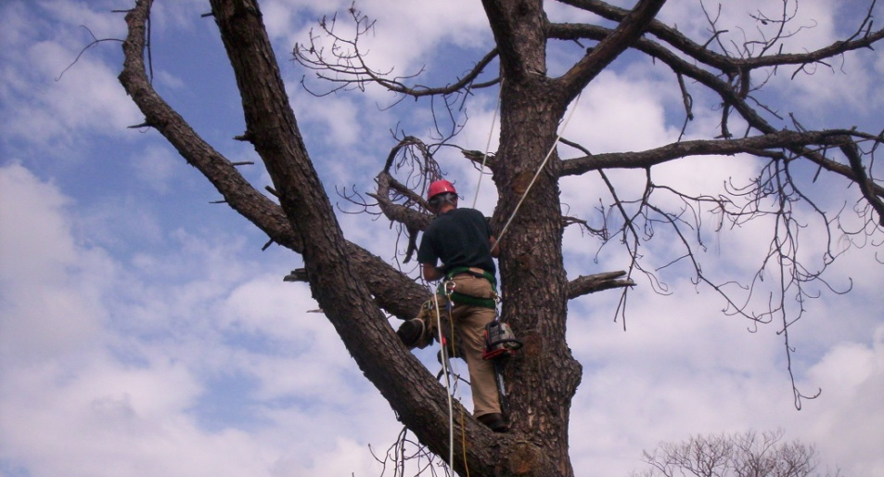
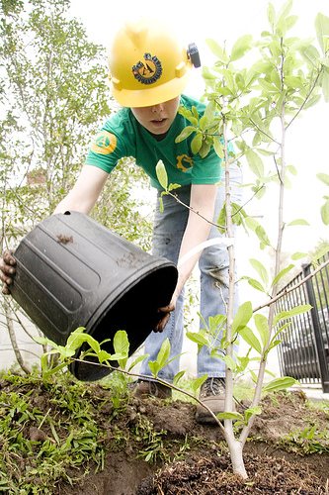
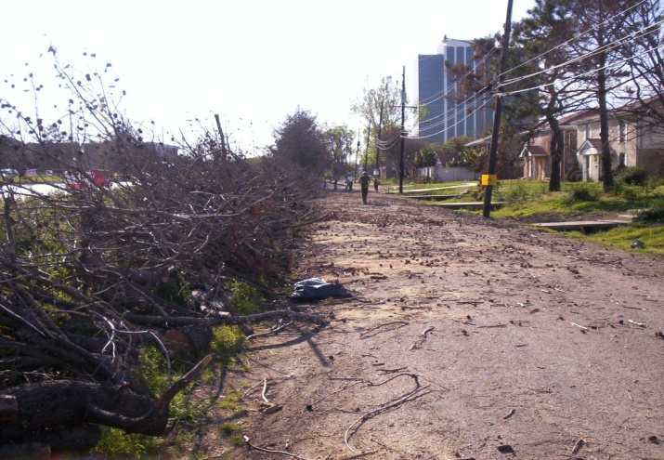
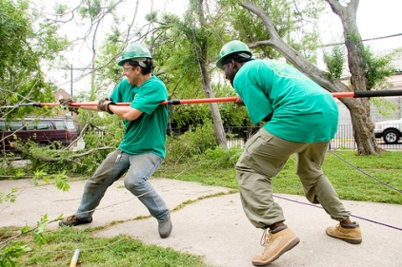
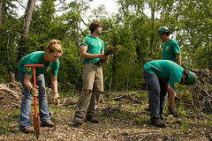
Hurricane Katrina, New Orleans, Louisiana
2006, 2007

Slide 42
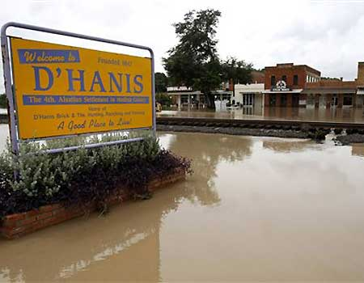
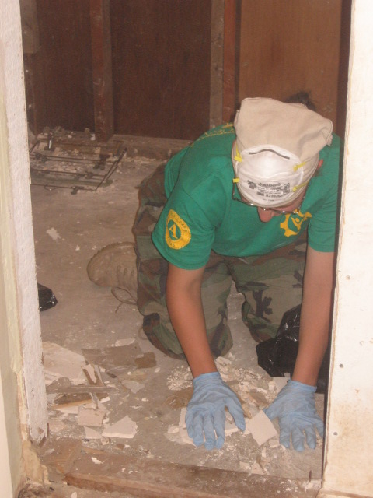
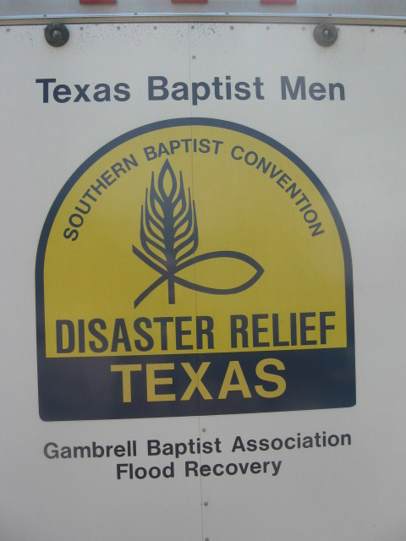
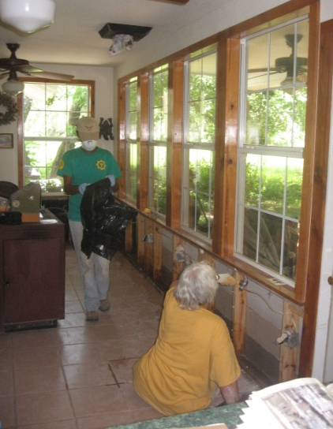
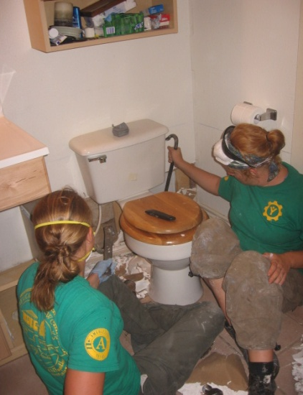
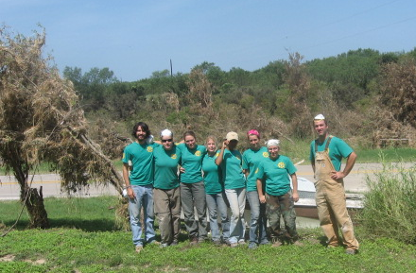
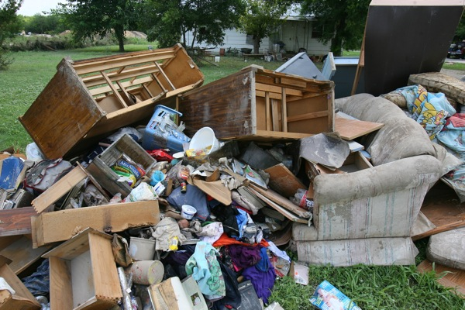
Seco Creek Flood, D’Hanis, Texas
2007

Slide 43
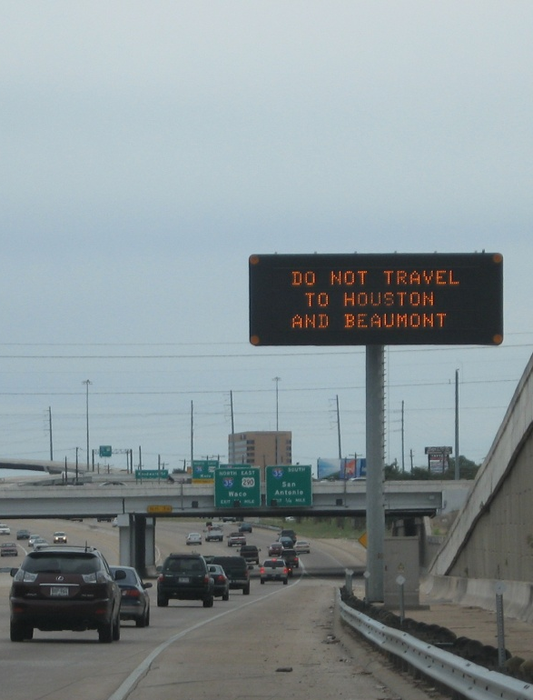
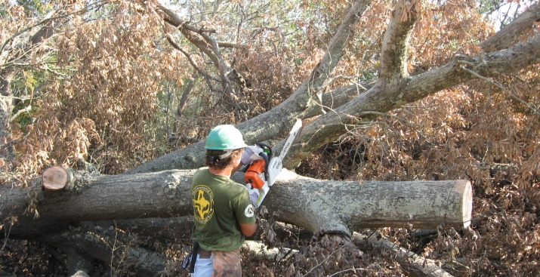
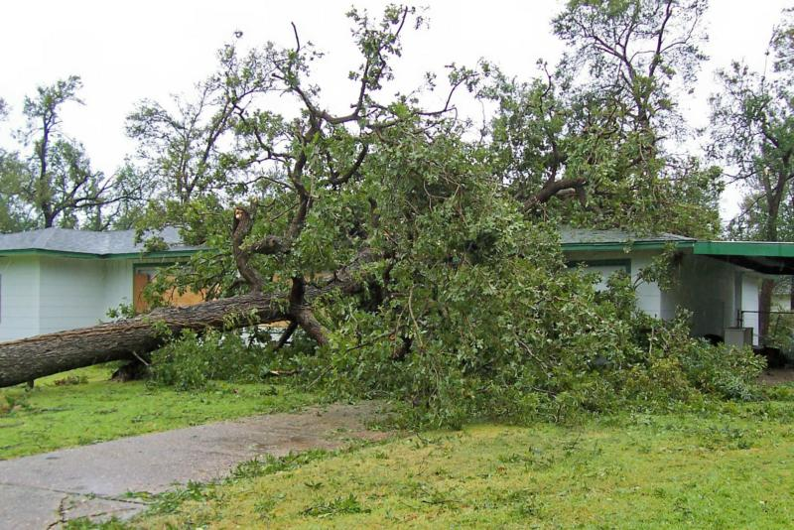
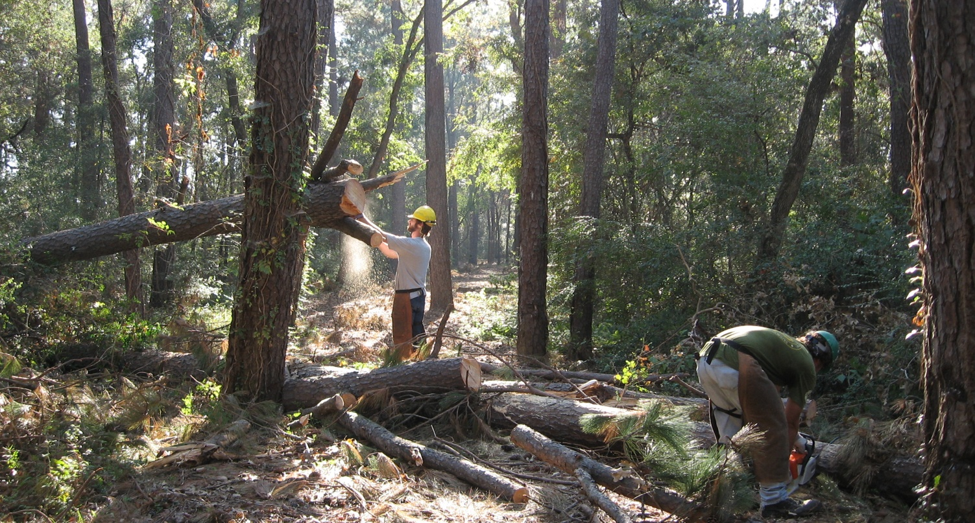
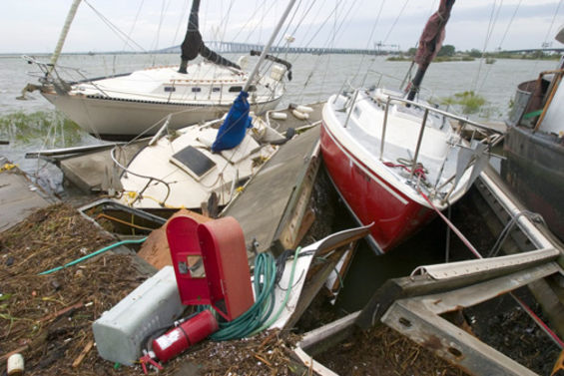
Hurricane Ike, Baytown, Texas
2008

Slide 44
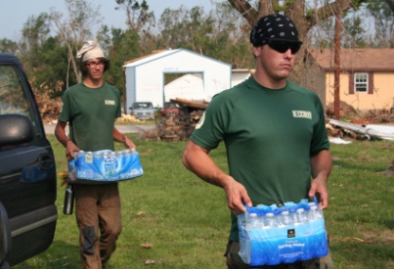
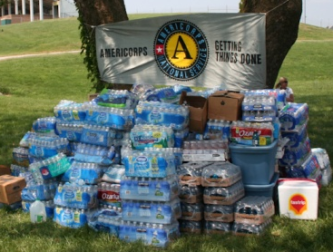
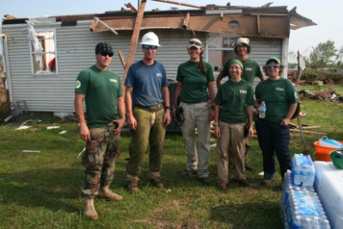
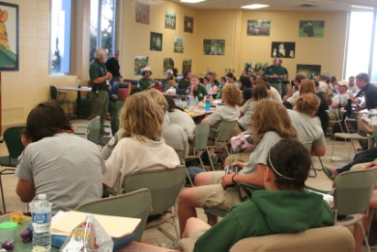
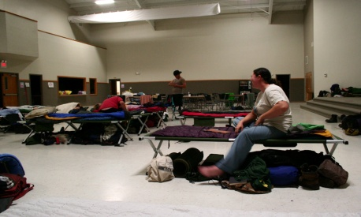
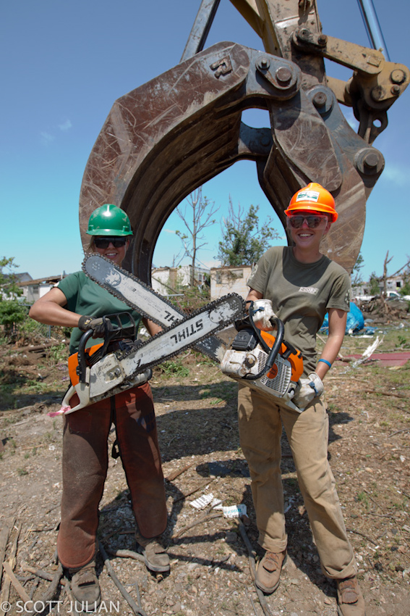
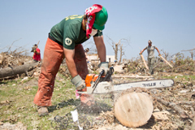
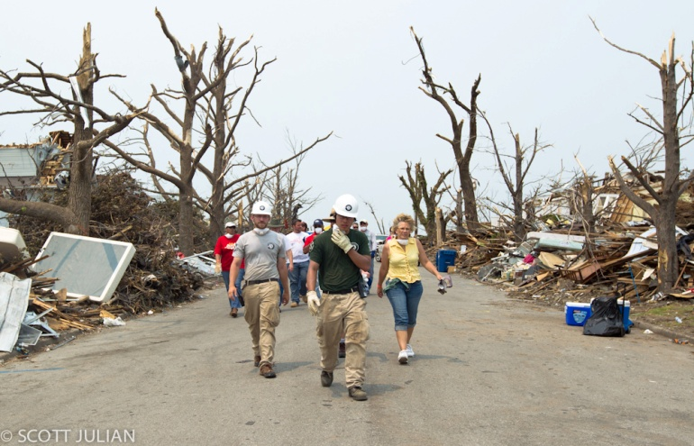
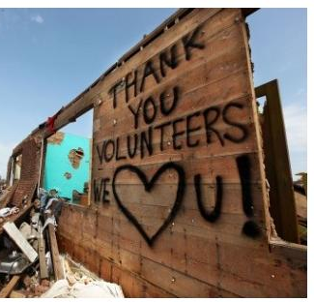
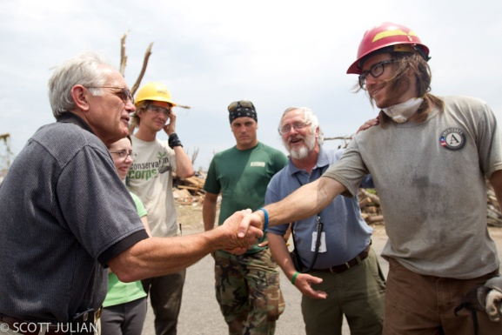
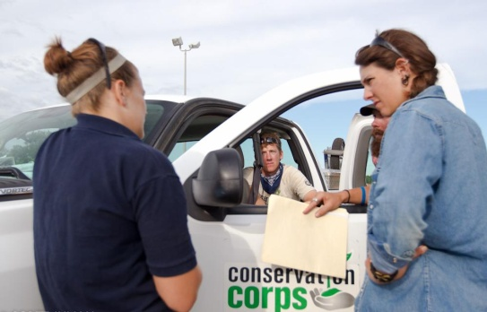
EF-5 Tornado, Joplin, Missouri
2011

Slide 45




Bastrop Complex Wildfire, Bastrop, Texas
2011

Slide 46







Hurricane Isaac, Baton Rouge & LaPlace, Louisiana
2012

Slide 47





Hurricane Sandy, NY & NJ
2013

Slide 48
Role in Disaster
Disaster Response Panel
Colin Foltz
AmeriCorps Member
Texas Conservation Corps

Slide 50
LUNCH – on your own
  See you at 1:30pm!
Notes:
Fiscal sessions will resume in Azalea/Bluebonnet
Program session will be in Lantana B/C

Slide 51
2013 AmeriCorps*Texas
All-Grantee Meeting
April 4-5, 2013

Slide 52
Inclusion Activities Update
Inclusion Team of Texas
Texas Disability Inclusion Symposium
Veteran Engagement
Mental Health Training
Materials
Leadership Council Inclusion group
Ongoing training and technical assistance

Slide 53
Inclusion News + Partnerships
In Texas, Everyone Can Serve: Stories of Disability Inclusion in Service and Volunteerism video

Slide 54
Inclusion Survey Results
1941 AmeriCorps*Texas members surveyed +
VISTA members
463 Responses
452 Completed Responses
23% Response Rate
Notes:
2012 42% response rate
No VISTAs surveyed

Slide 55
Inclusion Survey Results
6.2% of responders said either ‘yes’ or ‘unsure’ to being a person with a disability
25% of the above disclosed “learning disability” as their disability
21% of the above disclosed ‘mental illness’ as their disability

Slide 56
Inclusion Survey Results
91% AmeriCorps*Texas member
7% left blank
1.3% VISTA member
1.1% Veterans of the armed forces
Notes:
Thank you all for helping us reach members in order to have this survey completed.
We plan on providing brief (1 pager) survey result reports made up for each program site so that you can see details for your specific organization.
Here is an overview of some of our results.
Veterans represent ___% of survey responders. Keep veterans in mind, CNCS & NSIP are continuing to focus more and more on trying to recruit veterans into national service.

Slide 57
DARS Pilot Panel
Miranda Spiro, LMSW, Keep Austin Housed Coordinator, Front Steps
Diane Himmel, Unit Program Specialist, Department of Assistive and Rehabilitative Services, South Austin
Bobby Druesedow, Employment Assistance Field Specialist, Department of Assistive and Rehabilitative Services, Division of Blind Services
Notes:
Panel introductions

Slide 58
DARS Pilot Panel
What are the benefits to having a DARS consumer as AmeriCorps*Texas members?
How does it benefit programs? Members?
What kinds of supports can DARS offer both programs and members?
What do AmeriCorps programs need to know about DARS?

Slide 59
Thank you!
Suzanne Potts, LMSW, MPH
Senior Program Manager
Suzanne@onestarfoundation.org
Jane Murray
Senior Program Manager
JaneM@onestarfoundation.org

Slide 60
SNACK BREAK!
  See you at 3:30pm!
Notes:
Fiscal sessions will resume in Azalea/Bluebonnet
Program session will be in Lantana B/C

Slide 61
Program Round Robin:
APR Dos and Don’ts
Presenter: Anna Thiele

Slide 62

APR Do’s and Don’ts
Don’t mess with her!
Oh no! Not again! ☹

Slide 63
APR Do’s and Don’ts
Context: OneStar must submit a GPR (Grantee Progress Report) two times each year. We have 1-2 weeks to put together these reports which mostly include aggregated information taken directly from APRs.
Goal: To submit the right information to CNCS so that have a clear picture of our portfolio’s performance and our Program Officer doesn’t need to ask for additional information. Also, we want to be efficient with our time and eliminate unnecessary back/forth.

Slide 64

APR Do’s and Don’ts
The rows should match the PMs selected in eGrants.

Slide 65
APR Do’s and Don’ts
DO copy language exactly from your approved eGrants performance measures into the first four columns as well as the instruments column.

Slide 66
APR Do’s and Don’ts
DO review your last APR(s) to make sure that you remember what was discussed.
DO NOT make the same mistakes twice!

Slide 67

APR Do’s and Don’ts
DO add at least one “Great Story” that highlights what your members/staff/program do/does best! In fact, we hope you can submit a few stories!

Slide 68

APR Do’s and Don’ts
DO a double-check on the data quality!

Slide 69
APR Do’s and Don’ts
DO NOT leave unsatisfactory performance unjustified.
Assume we will need to give a detailed explanation for anything less than targets.
In some cases, you may need to also add a corrective action and plan for future improvement.

Slide 70

APR Do’s and Don’ts
DO add the three pieces of information for any percentages < 100%. If all three are less than 100%, you should be including twelve pieces of information. CNCS requests this information from us specifically so let’s get it right the first time!

Slide 71
APR Do’s and Don’ts
DO NOT leave required fields blank.

Slide 72
APR Do’s and Don’ts
DO NOT report data by region or service site. CNCS and OneStar expect data to be aggregated per grant.

Slide 73
APR Do’s and Don’ts
DO NOT use “Great Stories” as a catch-all for information that doesn’t fit in another place.
Use the Accomplishment tab for additional information.

Slide 74

APR Do’s and Don’ts
10 out of 10!
Smiles!
Smiling!
Thumbs up!

Slide 77

Stretch Break
60 seconds!
Video:
http://www.youtube.com/watch?v=K-cvcjvRokA&sns=em

Slide 78
Program Round Robin:
Branding, Visibility & Telling (More) Great Stories
Presenter: Emily Steinberg

Slide 79

Branding + Visibility

Slide 80


Branding + Visibility
Why does branding matter?
Sends a clear message
Invokes a promise,
a standard of service
Makes us stand out, but
  also part of something bigger
Let’s keep Wendy happy!

Slide 81
Branding + Visibility
From 2012-13 Terms & Conditions:
B-1: AFFILIATION WITH THE AMERICORPS NATIONAL SERVICE NETWORK.
    Identification as an AmeriCorps Program or Member. The Sub-Grantee must identify the program as an AmeriCorps program and eligible members as AmeriCorps members. All partnership agreements/MOUs related to the AmeriCorps program must explicitly state that the program is an AmeriCorps program and AmeriCorps members are the resource being provided.

Slide 82
Branding + Visibility
From 2012-13 Terms & Conditions:
    The AmeriCorps Name and Logo. All Sub-Grantee and Program Sub-Grantee websites must clearly state that they are an AmeriCorps Sub-Grantee and must prominently display the AmeriCorps logo. Sub-Grantees and Program Sub-Grantees except for Education Award Programs (EAPs) must use the AmeriCorps name and logo on service gear and public materials such as stationary, application forms, recruitment brochures, on-line position posting or other recruitment materials, orientation materials, member curriculum materials, signs, banners, press releases and publications related to their AmeriCorps program in accordance with CNCS requirements.
Notes:
Also goes on to say:
To publicize the relationship between the Program and AmeriCorps, the Sub-Grantee should use one of the following phrases when describing their program: "The AmeriCorps National Service Network", "an AmeriCorps Program," or “a proud member of the AmeriCorps national service network.” Sub-Grantees are strongly encouraged to provide information or training to their AmeriCorps members about how their program is part of the national AmeriCorps program and the other programs of CNCS. Sub-Grantees are strongly encouraged to place signs that include the AmeriCorps name and logo at their service sites and may use the slogan “AmeriCorps Serving Here.” AmeriCorps members should state they are AmeriCorps members during public speaking opportunities.
The Sub-Grantee may not alter the AmeriCorps logo, and shall obtain the written permission of the Commission and CNCS before using the AmeriCorps name or logo on materials that will be sold, or permitting donors to use the AmeriCorps name or logo in promotional materials. The Sub-Grantee may not use or display the AmeriCorps name or logo in connection with any activity prohibited in these grant provisions.

Slide 83

Branding + Visibility
Co-branding
Difficult to do
Refer to CNCS Graphic Standards Guide
Use official logos available available in Pantone Spot Color, grayscale, and reverse versions: http://www.americorps.gov/about/media_kit/logos.asp

Slide 84


Branding + Visibility
Graphic Standards to Avoid
Never run the AC logo sideways, upside down, or placed within a shape.
Use logos proportionally; don’t stretch or squeeze.
Don’t use logos less than ½ inch high.
Do not alter the fonts or colors.
Obtain written permission from CNCS before using logos on materials that will be sold.
Don’t use the image of the star in a red field (or in any other color field other
than the specified blue)

Slide 85

Shout-outs!

Slide 86

Shout-outs!

Slide 87

Shout-outs!

Slide 88

Shout-outs!

Slide 89

Shout-outs!

Slide 90


Shout-outs!

Slide 91

Shout-outs!

Slide 92
Telling Great Stories
Don’t forget to capture great stories along the way! Some ideas….
Provide storytelling training to your members/staff. It’s fun!
Require members to tell/write their stories throughout the year (as part of training, on reports, etc.). Ask them:
  Why did they join AmeriCorps?
  What is their favorite part of serving in AmeriCorps?
Survey your community partners (schools, agencies, community centers) to provide a quote/story about the impact of your program
Dedicate a page on your program/organization’s website to “Stories”
Host competitions for members to get their story published in your newsletter/blog/etc.
Use social media to post stories as they happen
Use smartphones or flip-cams to capture video footage!

Slide 94

Branding + Visibility

Slide 95
Stretch Break
60 seconds!
Video:
https://vimeo.com/61380481

Slide 96
Program Round Robin:
Performance Measurement & Data Quality Panel
Presenter: Laura West

Slide 97
PMs + Data Quality
Performance Measurement
Introducing… the CNCS Performance Measure Data Quality: Self-Assessment
CNCS will incorporate into monitoring in 2014
OneStar piloting now
Assesses data quality, not performance

Slide 98
PMs + Data Quality
Performance Measurement
CNCS wants to know that:
You are measuring what you said you will measure
You have all the data you need to measure it
You are using standard protocols and procedures to collect data
Your data are generally error-free
You have some sort of quality assurance practice in place to ensure the quality of PM data reported

Slide 99
PMs + Data Quality
Welcome to our Panelists!
Miranda Spiro, Keep Austin Housed (OnCorps)
Daniel Yarritu, UT-Brownsville (Sharepoint)
Abby Ames, Breakthrough Austin (Salesforce)

Slide 100

Importance of Data Collection
Individual student progress over time
Staff turnover
Accountability
Inform decision-making

Slide 101
Context
From spreadsheets to database
Constantly changing and improving
Volunteer support
Staff training and buy-in

Slide 102
Our Performance Measures
Middle school summer program (statistically significant gains in Reading, Writing, and Math)
Annual student recruitment
Continued student participation
On-time high school graduation
Post-secondary institution enrollment
Notes:
Middle school summer program (statistically significant gains in Reading, Writing, and Math)
Annual student recruitment (serve more students)
Continued student participation (low attrition)
On-time high school graduation
Post-secondary institution enrollment

Slide 103

Salesforce
Individual Student and Family Information
  Demographics
  Contact Information
Programmatic Information
  Case Management/Contact Notes
  Grades and Attendance
  Test Scores
  Event Attendance
  Milestones
Reporting

Slide 104

Salesforce Dashboard

Slide 105

Student Account

Slide 106

Individual Student Data
Grades and Attendance

Slide 107


Aggregate Data

Slide 108

Event Attendance and Activity

Slide 109

Case Note

Slide 110

College Application & Scholarship Info

Slide 111

College Enrollment Report

Slide 112

College Enrollment Graph

Slide 113

Data Integrity
Data sharing agreements
Initials listed for each case note
Training and team work
Frequent checks: student progress meetings
Reports

Slide 114
Resources
Performance Measurement
For additional performance measurement resources, go to the new PM Core Curriculum:
http://www.nationalserviceresources.org/npm/training-resources

Slide 117
Stretch Break
60 seconds!
Video:
https://www.youtube.com/watch?feature=player_embedded&v=4ZfWxgdVm58

Slide 118
Wrap-up
Fashion Show
Rainey Street
  See you tomorrow at 8:30am!
Notes:
Welcome back to fiscal staff!
Recap of the day
Arrival time tomorrow – 8am breakfast, 8:30 start
Reception in Upper Dining Room! Fashion Show! Models may change in the bathroom just below the dining hall. It’s not too late to sign up! All participants will win a prize. For grand prize, judges will be looking for: 1) national service spirit/attitude 2) best integration of the AmeriCorps brand 3) prominent placement of AmeriCorps logo.
Rainey street outing – leave from the Upper Dining Area at 6:30. OS staff will guide. 10 minute walk, 3 minute drive. Carpool if desired, but parking is limited! Lots of dining options. ATM available.

Slide 119
2013 AmeriCorps*Texas
All-Grantee Meeting
April 4-5, 2013

