Slide 1

2013 AmeriCorps*Texas
All-Grantee Meeting
April 4-5, 2013

Slide 2
Overview
Agenda – Day 2
  CEO / CNCS State Director Welcome
  Civic Reflection
  Break
  Understanding AmeriCorps Evaluation Requirements
  Texas Connector Demonstration
  Lunch (on your own)
  National Service Criminal History Check Town Hall
  Break
  Test Your AmeriCorps Knowledge: Jeopardy!
  Close/wrap-up (3:30)

Slide 3


CEO Welcome + Intros
Welcome!
Liz Darling, President/CEO, OneStar Foundation
Terry Gunnell, Texas State Program Director, Corporation for National and Community Service

Slide 4
Civic Reflection
Civic Reflection Activity
What is it?
Civic reflection is the practice of reading and discussing short pieces of literature or other media as a means of reflecting on
the central questions of civic life.
Why are we doing it?
To help us reflect on our values, choices and ideas
To think more deeply about our work
To build connections between each other
To respond more imaginatively to the needs of our communities.

Slide 5
Civic Reflection Groups
Abby Ames (Group 1) – Lantana B
Jennifer Rajkumar (Group 2) – Lantana C
Jeremy Fox (Group 3) – Azalea
Jerry Bertrand (Group 4) – Tavern
Keshia Bruno (Group 5) – Upper Dining Hall
Mareko Prior (Group 6) – Bluebonnet

Slide 6

Civic Reflection Resources
www.civicreflection.org

Slide 7
Understanding AmeriCorps Evaluation Requirements
Presenters: Erin Brackney, Emily Steinberg

Slide 8
Why Evaluation Matters
Accountability and Stewardship
  CNCS / OneStar
  Other Funders, Supporters, and Advocates
  Taxpayers
Continuous Improvement
  Data-Driven Decisions
  Working smarter, better, faster (and cheaper!)
Increasing Knowledge-Base of our Field
  Sharing What Works
  External Communications
  Contributing to the “Larger Solutions”

Slide 9
What We’ve Learned
Lessons from the Statewide Evaluation
  Contributed to the field on a state/national level, but not a program-specific level
  Difficult to evaluate diverse program designs
  Limited budget = limited scope
Approach Moving Forward
  Bring evaluation back to the program-specific level
  Provide portfolio-wide guidance and TTA
  More “hands on” to ensure both parties (grantee/subgrantee) get meaningful results

Slide 10
AmeriCorps Requirements
§2522.710: Type of evaluation required
  If the CNCS Share is $500,000 or more, you must arrange for an external evaluation of your program.
  If the CNCS Share is less than $500,000, or you are an Education Award Program grantee, you must conduct an internal or external evaluation of your program.
Notes:
Previously, OneStar conducted a Statewide Evaluation of AmeriCorps programs that met requirements for participating programs for the following grant cycles:
2009-10
2010-11
2011-12
However, starting with the 2012-13 grant cycle, OneStar will NOT conduct a Statewide Evaluation; therefore, grantees will need to meet the CNCS Evaluation Requirements on their own and must include information in their applications about how they will meet the CNCS Evaluation Requirements by conducting their own internal or external evaluation in accordance with the instructions below.

Slide 11
AmeriCorps Requirements
§2522.720: Duration
  Must cover minimum of 1 year
§2522.730: Submission Process
  Must submit with grant application each time you recompete
  For first recompete, must submit Evaluation Plan / summary of evaluation efforts to date
  For subsequent recompetes, must submit a copy of completed Evaluation Report from previous project period
Notes:
Reference chart!

Slide 12
AmeriCorps Requirements
§2522.740: How CNCS Uses Evaluations
  To determine eligibility for future funding (if you do not include your required plan/report, CNCS reserves the right to not consider future grant applications)
  To assess the “quality and outcomes” of your program

Slide 13
AmeriCorps Requirements
§2522.810: What will CNCS do to evaluate the overall success of AmeriCorps programs?
  CNCS will conduct its own independent evaluations of programs to examine:
    Extent of impact on communities
    Extent to which national servicer increases positive attitudes and civic engagement among participants
    Extent to which national service enables participants to afford and enroll in post-secondary education
    Cost effectiveness of different program designs/models
    The effect the living allowance has on individuals’ ability to participate in national service
    Whether State/National Priorities are being addressed

Slide 14
AmeriCorps Requirements
§2522.820: Confidentiality
  CNCS (and OneStar) will maintain confidentiality of information regarding individual participants/ respondents.
  CNCS will only release participant information if:
    It is in aggregate form (by site, program, state, etc.)
    Prior written consent of the individual was obtained

Slide 15
OneStar Requirements
OneStar-specific guidelines –
Evaluations should:
  Should mention ‘AmeriCorps’
  Should consider and focus on AmeriCorps-specific impact (not just organizational impact)
  Should include Texas-specific data and outcomes
  Should discuss areas of future exploration for further study
  Should include a 1-3 page Executive Summary
  Should speak to AmeriCorps ‘triple bottom line’

Slide 16

Triple Bottom Line
Impact on beneficiaries
Impact on members
Impact on communities

Slide 17

Questions?

Slide 18
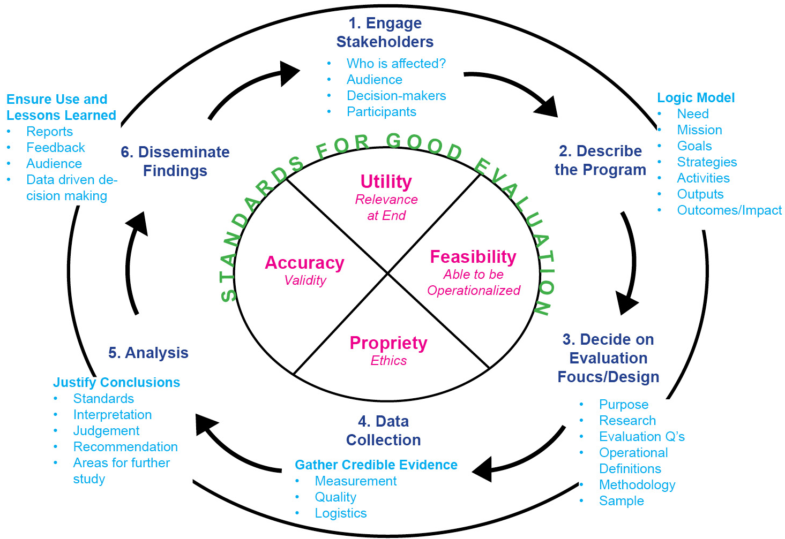
The Evaluation Cycle

Slide 19
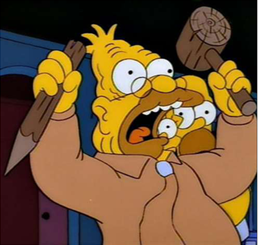
The Evaluation Cycle
Engage Stakeholders
  Who’s in charge?
    Decision-Makers
    Evaluators
  Who’s the target?
    Participants
  Who’s the audience?
    Staff
    Board
    Funder/Donors
    Public

Slide 20
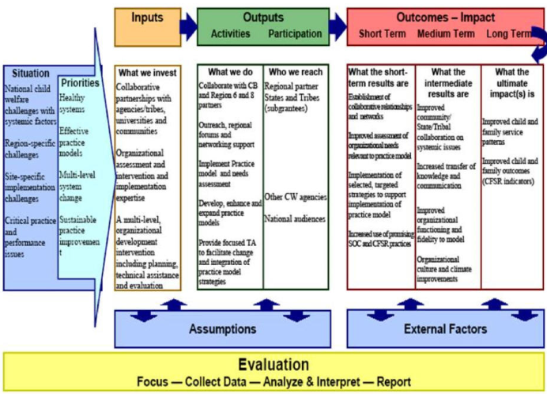
The Evaluation Cycle
2. Describe the Program
  Logic Model
    Need
    Inputs
    Strategies
    Activities
    Outputs
    Outcomes/Impact

Slide 21
The Evaluation Cycle
3. Decide on Evaluation Focus & Design
Purpose
Research
Evaluation Type
    Needs Assessment – Explores need for a program
    Process Evaluation – Assesses program delivery as intended
    Impact (Outcome) Assessment – Determines program effect/impact on social challenges
Evaluation Questions
    Specific
    Reasonable & Appropriate
    Answerable
Notes:
What do you want to learn?
What did you think would happen?
What does change look like?
What do you need to evaluate to determine if you are truly making a difference?
Prioritize!

Slide 22

The Evaluation Cycle
Operational Definitions
Methodology
  Quantitative (E.g. Survey Instruments: Beck Depression Inventory)
  Qualitative (E.g. Focus Groups, Historical Research, Participant Observation)
  Anecdotes
Ethics
  Safeguard participants from harm
  Informed consent
  Confidentiality/Anonymity
Sample
Notes:
Quantitative
Numeric – Statistical Analysis
Deductive – tests a theory or hypothesis
Broad but shallow
Tend to be more valid, reliable, generalizable
Qualitative
Non-numeric – Content Analysis
Inductive – creates a theory
Rich data – narrow but deep
Less generalizable

Slide 23

The Evaluation Cycle
4. Data Collection
Gather Credible Evidence
Measurement
  Type (Determined by Methodology)
  Baseline & Intervals
Quality
Logistics
Notes:
Keep it simple
Not just “did it work, but “what about it worked?”
Baseline
Optional
Occurs before implementation of program
E.g. CCAT
Midpoint/Intervals
Benchmarking
Continuous Improvement
Posttest
Looking Back: What happened, How & Why?
Longitudinal
Follow-Up, Over time

Slide 24
The Evaluation Cycle
5. Analysis – A systematic way of assessing the data to justify conclusions
  Standards
    Methodological Rigor
  Interpretation of Results
  Judgment
    Conclusions
    Meaning of Results
  Recommendations (So, what?)
  Areas for Further Study (What’s next?)
Notes:
SPSS – Statistical Analysis
Content Analysis
Give Example: Ari’s CIS Example

Slide 25

The Evaluation Cycle
6. Disseminate Findings
Ensure Use and Lessons-Learned
Reports
Feedback
Audience
Data-Driven Decision-Making
Notes:
Keep information useable
Analyze your stakeholders
Statistics
Stories

Slide 26

Closing
A Few Things to Remember…
Involve stakeholders from the beginning and throughout!
Keep it simple.

Slide 27
Closing
Materials & Resources
Evaluation Plan Template
  Texas Connector Evaluation Plan Outline
  Oregon AmeriCorps Programs Evaluation Plan
Where to find an evaluator
  Local College/University School of Social Work
  American Evaluation Association: http://www.eval.org/
  Association for Research on Nonprofit Organizations and Voluntary Action (ARNOVA): http://www.arnova.org/
27
Notes:
27

Slide 28
Questions?

Slide 29

Texas Connector Demonstration

Slide 30


Slide 31
LUNCH – on your own
  See you at 1:30pm!

Slide 32
NSCHC Town Hall:
Report-back from 2012 Self-Audit and Looking Ahead at 2013 and Beyond
Presenters: Anna Thiele, Emily Steinberg

Slide 33
NSCHC Town Hall
Overview of 2012 NSCHC Self-Audit
What OneStar and grantees did
Why we did it
Where we are now
Notes:
Be sure to thank programs for all the hard work they put into the self-audit.

Slide 34
NSCHC Town Hall
What did you learn from doing the self-audit?
Did you discover best practices that you had or did you subsequently develop best practices as a result of the self-audit that you would share with others?
General tips to share with other programs about NSCHCs from what we’ve learned in the past several years.
Notes:
Best NSCHC Self Audit Award from 2012 goes to… CIS-Central Texas!

Slide 35
NSCHC Town Hall
Best Self-Audit Award
Trends from OneStar’s Perspective
Looking Ahead

Slide 36


Slide 37
BREAK!
  See you at 1:45pm for your final challenge!

Slide 38

Test Your AmeriCorps Knowledge!

Slide 39
Close/Wrap-up
Evaluations

Slide 40
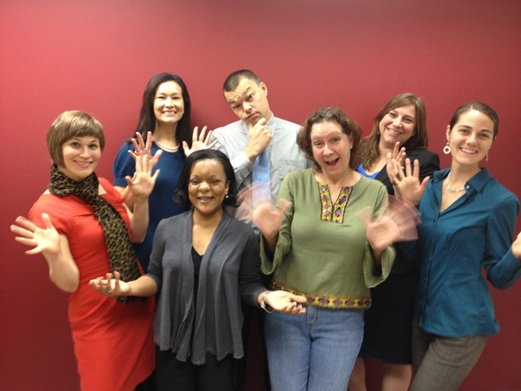
  See you next year!

Slide 41
2013 AmeriCorps*Texas
All-Grantee Meeting
April 4-5, 2013

