Slide 1
2017 AmeriCorps Texas
All-Grantee Meeting
March 1-2, 2017
2016 AmeriCorps Texas
All-Grantee Meeting
February 25-26, 2016

Slide 2
(Shining a light on)
Living Allowance

Slide 3
Living Allowance
In this session, we will cover:
Basics
Guidance
What If’s
Common Errors

Slide 4
Living Allowance
OneStar Living Allowance Guidance:
A payroll schedule should include:
A list of all paychecks that will be issued with a period of time covered
Date of each paycheck
Amount of each paycheck
Beginning date of first pay period should match the member’s enrollment date (in My AmeriCorps) and the beginning date listed in the member service agreement
Ending date of the last pay period should match the member’s exit date (in My AmeriCorps) and the ending date listed in the member service agreement.
Notes:
Mary
You’ll see an example of a living allowance pay schedule on the next slide

Slide 5
Living Allowance
Date of paycheck
First day of service
Gross pay (i.e. pre-tax amount)
Notes:
Mary
What do you notice about this pay schedule?

Slide 6
Living Allowance
Fill this in for each member type
This should be the same for every member type
Last day of service
Notes:
Mary

Slide 7
Living Allowance
OneStar’s Living Allowance Guidance
Member Service Agreements should include:
Required term of service (start and end date)
Total Living allowance amount for a successful completion of a service term
Note: Minimum LA applies to FT members, and maximum LA applies to all members
A list of what constitutes a successful completion of term of service
A payroll schedule
Notes:
Jaclyn

Slide 8
Living Allowance
2016 - 2017 Min & Max
2017 - 2018 Min & Max
Notes:
Jaclyn

Slide 9
Living Allowance
There are Two Kinds of Members:
Those who serve their term as planned
Those who don’t serve their term as planned:
Late starters
Early Exit for Compelling Personal Circumstances
Early Exit for Cause
Duration of Service Waiver
Suspensions
Converting Member Types
Notes:
Jaclyn

Slide 10
Living Allowance
How to Handle Off-Schedule Living Allowance Payments:
Step 1: Determine Correct Enrollment/Exit/Suspension Date
Step 2: Calculate the revised payment amount
Step 3: Double check your dates and dollars
Step 4: Have someone review the paperwork for consistency.
Notes:
Jaclyn

Slide 11
Living Allowance
Guidance for when a member is not active for the entire pay period…
CNCS’ FAQ C10 recommends that programs develop a reasonable written policy for instances when members start late or leave early.
You can establish different cut-off points as long as they are reasonable, documented in written policy, and followed consistently.
If a member is suspended, then the member should receive pay through the day before the suspension date in eGrants.
Notes:
Jaclyn

Slide 12
Living Allowance
Determining Appropriate Effective Dates:
Enrollment: A member enrollment date should be the first date of the member’s service (includes orientation/training).
Suspension: The day the program determines that the member should be in suspended status and communicates this to the member.
Notes:
Jaclyn
Memo Hand Out

Slide 13
Living Allowance
Determining Appropriate Effective Dates:
Exit: The effective date for an unplanned exit from a program:
When a member resigns: the date the member notified the program that he/she has resigned. If member resigns by email/voicemail/text, the effective date is the date of the communication.
When a member is terminated: The date the program notified the member that he/she was terminated.
When a member is released for personal compelling: Circumstances may vary so come to OneStar to discuss, if not clear.
Notes:
Jaclyn

Slide 14
Living Allowance
PLANNED SERVICE: Sept 8, 2016 – July 29, 2017
EARLY EXIT: May 27, 2017
LATE START: September 28, 2016
SUSPENSION: November 3, 2016 – November 12, 2016
Notes:
Mary

Slide 15
Living Allowance
Calculating pro-rated payments
2 options:
Calendar Days
Number of Days Served/Number of Calendar Days
Business Days
Number of Days Served/Number of Business Days
Multiply the result by the full stipend amount to arrive at the pro-rated amount
Be consistent!
Notes:
Mary
Walk through the calculations. For calendar days – different result for 10 days served in a month with 31 says than 30 days. For business days, do you plan to include holidays? Either way, specify this in your policy.

Slide 16
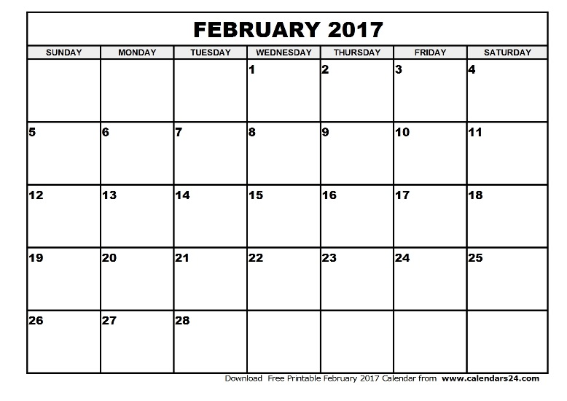
Living Allowance
Calculation Example
Suzy’s exited early for CPC on 2/10/17. Her MSA lists $600 bi-monthly stipend payments with pay periods ending on the 15th and last day.
Calendar Days:
10/15 X $600 = $400
Business Days:
8/11 X $600 = $436.36
Notes:
Mary
For business days, use the laser pointer to count the days

Slide 17
Living Allowance
Common Errors
Incorrect, unclear or misaligned enrollment, suspension, and exit dates in My AmeriCorps, the member file, member timesheets, and pay records.
A member may not receive more living allowance per pay period due to serving a shorter term.
Inconsistently prorating stipend payments.
Service hours accrued and or living allowance paid after the exit date.
Notes:
Mary
-the dates on your various documents must match
-members don’t receive “extra” money for finishing their service more quickly
-use the same pro-rating method for every member.
-when a member’s service ends, the pay and hours stop on that date.

Slide 18
Living Allowance
In conclusion:
Ensure dates and payment amounts align exactly between all program and fiscal documents including the member service agreement, member living allowance schedule, timesheets, other AmeriCorps-specific documents/My AmeriCorps, the AmeriCorps budget, actual dates/amounts paid, etc.
Notes:
Mary

Slide 19
Notes:
We have a few minutes for questions…

Slide 20
2017 AmeriCorps Texas
All-Grantee Meeting
March 1-2, 2017
2016 AmeriCorps Texas
All-Grantee Meeting
February 25-26, 2016

