Slide 1
2017 AmeriCorps Texas
All-Grantee Meeting
March 1-2, 2017
2016 AmeriCorps Texas
All-Grantee Meeting
February 25-26, 2016

Slide 2
Welcome to AGM!
Welcome to Austin
AGM 2017 Theme
Intro to OneStar team
Housekeeping announcements
Notes:
Emily to say “Good Morning, everyone. Thank you to all of you for being here and especially to those of you who traveled from far and wide to be with us this week. We know that you all lead extremely busy lives and work incredibly hard to “get things done” for Texas.
First off, welcome to Austin. We hope you’ll enjoy this year’s central location at the Hilton Garden Inn and get to explore downtown! We have maps out at the Registration Desk with a list of good eateries and fun things to do within walking distance. We are intentionally giving you lunch on your own today so you can take some time to get outside and enjoy the city as a break. And if 6th street isn’t your style, there’s also 5th street, 4th street, 2nd street, Rainey street, and so many other neighborhoods to choose from ;)
As you may have noticed, we have a theme going on for AGM 2017: “The AmeriCorps Journey”!
Why this theme? You could be running on your journey, walking, or crawling; escaping something, running towards something, journeying alone or with a friend, taking the beginner trail or the advanced one! OneStar is here to help you on your Journey no matter where you are. Consider us your guides ☺
We encourage all of you as participants to get ready for YOUR AmeriCorps journey! Tomorrow, we encourage all of you to wear your hiking/running/mountain climbing/outdoorsy gear for our last day of training – as long as you have an AmeriCorps pin, sticker, or nametag as well for branding of course!
We’ve also strategically placed AmeriCorps logos down the hall to encourage you to walk to the logo on a break and take a selfie.
And if you’re a social media user, feel free to post your selfies and photos with the hashtag #AmeriCorpsJourney (tag @OneStarFdn too!)
I also wanted to take a moment to introduce the OneStar team as we have some new faces and recent announcements:
Most of you know me, but I’m Emily Steinberg, Director of National Service. As most of you have heard by now, this is actually my last couple of weeks at OneStar. Starting March 13th, I will be transitioning to a new role as Director of External Affairs at our national association of state commissions, America’s Service Commissions (ASC). But I’ll still be working from Austin, and hope to see some of you at various events like the regional conferences, AmeriCorps Opening Days, and such. So don’t forget about me yet! ☺
Next up, we have our 2 Grants Officers Mary Voorhies… Deloris Robinson…
Betty Jo Schafer, UT MSSW Intern / OneStar Graduate Fellow
Miranda Spiro, who will also be making a big change soon to become the Grants & Contracts Administrator for Foundation Communities, a housing nonprofit here in Austin that fights poverty and homelessness. We are so sad to see her go, but know that she will continue to be a passionate AmeriCorps Alum for life!
And last but not least, Jaclyn Kolar, who will be stepping into an exciting new role of Manager, AmeriCorps*Texas to lead the team moving forward. And in fact her first “day on the job” happens to be today – March 1st!
Jaclyn, would you like to say a few words?
You may have also noticed Elisa isn’t here with us this week… long-deserved Sabbatical. She will be easing back in starting next week.
HOUSEKEEPING:
Wi-Fi Password
Restrooms
Meals / dietary restrictions
Cell phones on silent
Photos being taken
Town Hall – Question Backpack
Branding Kits – TAMIU, LSC-K, TxCC, Relay
Handouts – limited paper copies available. All will be posted online on our Grantee Resource Library and link sent out in Monday’s AC Update afterward.
Survey will be sent out right after we conclude tomorrow – please give us your feedback

Slide 3
Elisa says hello from Sabbatical!
Notes:
Elisa also wanted me to let you know what she has accomplished during her Sabbatical so far these past 4 weeks including:
Memorized the words to most of the Hamilton soundtrack
Rediscovered her love of Mariah Carey’s Music Box
Painted and decorated her son Jacob’s new “big boy” room
Organized her Game and Puzzle Closet
Woken up at 5:15am daily to work out
Created a craft space in her study
Gotten a haircut for the first time since 2015
Planned and volunteered at her other son William’s Valentine’s Day party
In Progress: Organizing 5 years worth of school papers, art, and holiday cards
Still to do: Hemming her living room curtains!

Slide 4
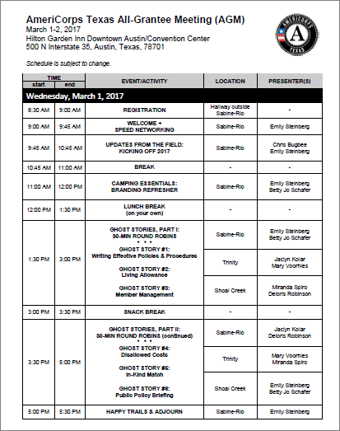
Agenda Overview – Day 1 (Weds)
Notes:
After Speed Networking is done, transition to Agenda Overview.
-We have a great agenda these next 2 days – and lots of quality time with all of the OneStar staff.
-Then this afternoon, we’ll be breaking into 3 smaller “cohort” groups to rotate between sessions we’re calling “Ghost Stories.” Each session is a quick 30-minute round robin where you’ll get the basics behind each topic/concept before you hear from the next group. One group will stay here, one will go next door to Trinity, and the third group will be down the hall in Shoal Creek. The presenters will rotate (not you!).
-Show of hands: how many of you plan to attend Programmatic sessions? Fiscal? Either way, we have some great content these next 2 days you will find helpful in managing your AmeriCorps (and perhaps other federal) grants.

Slide 5
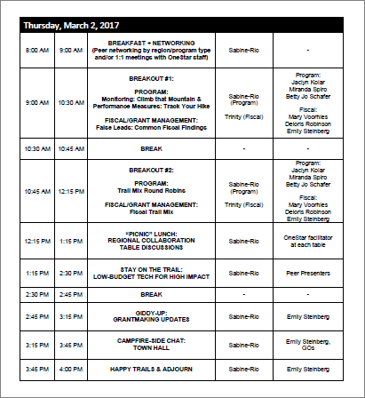
Agenda Overview – Day 2 (Thurs)
Notes:
HOUSEKEEPING:
-BREAKS/LUNCH: We’ll have 2 breaks per day (one mid-morning at 10:30am, and one mid-afternoon at 2:15pm) and two “working lunches” to maximize our time together and ensure allowability of charging our time (of course!)
-RECEPTION: Tonight is an optional-but-encouraged Complimentary Reception sponsored by the Wyndham, with some really nice appetizers and beverages and a chance to strut your stuff, win prizes, continue your networking, and take photos in our Photo Booth!
-SCAVENGER HUNT CHALLENGE (pass out): First 10 people to complete all 10 items will win a prize!
-SOCIAL MEDIA AND PHOTOS: Don’t forget to tweet or post on social media about All-Grantee Meeting – make sure to tag @OneStarFdn (Hint: this is part of the scavenger hunt challenge!)

Slide 6
Welcome + Speed Networking
Instructions
If your last name ends with A-J, you are a “1”
If your last name ends with K-Z, you are a “2”
1’s: Stand up and make a line
2’s: Stand up and make a line facing the 1’s – you will rotate every 2 minutes when you hear me announce time is up.
We’ll do this for about 30 minutes.
Notes:
Emily to say “Good Morning and Welcome. As you may have noticed, we have a Star Wars theme going on for the 2016 AGM.
Thank you to all of you for being here and especially to those of you who traveled to be with us in Austin this week. We know that you all lead extremely busy lives and work incredibly hard to “get things done” for Texas.
To get started, I’d like for all of us to take a few minutes to get to know some of those around us. At your tables, please go around and tell your tablemates the following: Your Name, Organization, Title and What You do, and which Star Wars character your are and Why (or, if you’re not a Star Wars fan), pick another fictional movie character!

Slide 7
Speed Networking!
You each have 1 minute to tell the other:
Your Name
Title/Role
Organization
Where are YOU on your AmeriCorps journey? (beginner, intermediate, advanced, other)
Bonus: What is your favorite outdoor activity? (ex. camping, hiking, fishing, hunting, birdwatching, etc.)
SWITCH – now hear from your partner!

Slide 8
Updates from the Field:
Kicking off 2017

Slide 9
Updates from the Field
Agenda
Executive / Federal Budget Update
Grantee Expectations
Portfolio Highlights and Trends
Portfolio Challenges
2017 Engagement Calendar

Slide 10
Welcome & Executive Updates
Chris Bugbee,
Chief Operating Officer

Slide 11
Now a quick celebration…
IPERA
Notes:
But before we celebrate something To-Be-Announced, please look under your table to find some special party supplies to celebrate with. You should have enough supplies for each person at your table. Go ahead and take yours out!

Slide 12
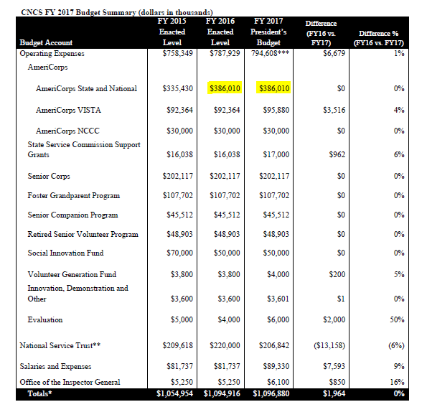
FY17 Federal Budget Request (CNCS)
Notes:
Since then, on February 9th, President Obama released his budget request for Fiscal Year 2017, including a budget request of $1.1 billion for CNCS. If enacted, this funding level will enable AmeriCorps, Senior Corps, and the Social Innovation Fund to expand and would support an estimated 88,400 AmeriCorps members (up from previous year) as well as invest in promising and evidence-based approaches to improve the lives of low-income individuals through the Social Innovation Fund; focus on competition-based funding of Senior Corps programs to engage Americans age 55 and older; and continue to identify, generate, and disseminate evidence of the impact of national service.
OneStar and our very own Texas Conservation Corps were also featured in CNCS’s Congressional Budget Justification for our work in Disaster Services through AmeriCorps, general coordination, and our previous Volunteer Generation Fund (VGF) program.
While there’s still a long road to travel before this budget will be voted on or approved, this is a strong budget request that shows ongoing support for our nation’s volunteer sector, Governor-Supported State Service Commissions and our subgrantees (like you), and the importance of building capacity of organizations to recruit and retain volunteers to address critical community needs.

Slide 13
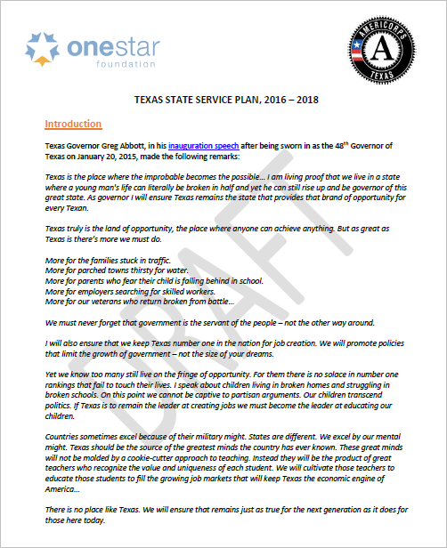
2016-18 State Service Plan
Federal requirement every 3 years
Supplemental Plan for Adults 55+
Governor must approve
Outlines state priorities
Notes:
As required by the Code of Federal Regulations §2550.80 , state service commissions like OneStar are required to develop a comprehensive 3-year State Service Plan and Supplemental Plan for Adults age 55 and older. The purpose of these documents is to outline our strategies and goals for administering AmeriCorps funding and developing national and community service programs and networks in alignment with state-specific priorities.
In January, both of OneStar’s Boards of Directors approved our 2016-2018 Draft Plan, which has now been shared with the Governor’s office and is awaiting Governor’s Office approval before we can share it publicly.
However, we wanted to share with you an Embargoed Draft in advance of publication. Some key highlights:
Aims to align our work with the Governor’s Priorities;
Includes recent demographic data and trends from Texas State Demographer Dr. Lloyd Potter
Simplifies our Priority Focus Areas to 3: Youth Educational Attainment (with additional priority placed on programs addressing two key Governor Emergency Priorities*: Early Childhood Education and Reading Excellence), plus Disaster Services and Veterans & Military Families
Includes a robust Supplemental Service Plan for Texans Aged 55 and Older, in cooperation with the CNCS Texas State Office, which will prioritize the use of 55+ volunteers and multi-generational service activities by making it a priority for new program development and in AmeriCorps funding decisions.
Outlines 8 key initiatives/strategies OneStar will focus on to improve and strengthen service across Texas

Slide 14
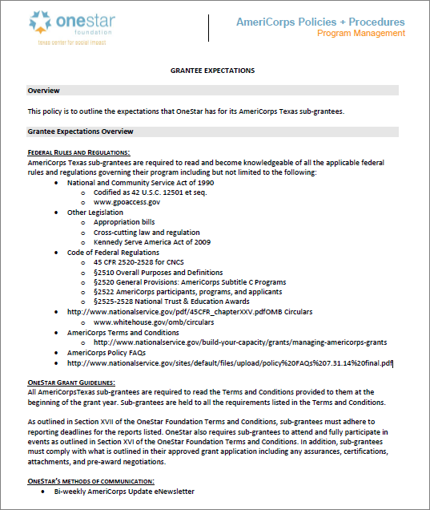
Grantee Expectations
Posted online in Grantee Resource Library
Notes:
Pass out handout and go over it briefly (5 minutes/page – total 15 minutes)
http://onestarfoundation.org/wp-content/uploads/2014/10/Grantee-Expectations-Policy-2017.pdf

Slide 15
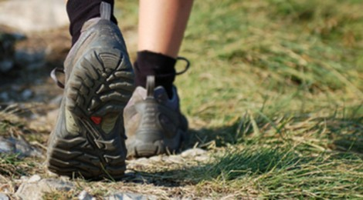
Highlights and Successes
Steady, Sustainable Growth
Portfolio numbers / Boots on the Ground
 | 2012-2013 | 2013-2014 | 2014-2015 | 2015-2016 | 2016-2017
# of Grantees | 20 | 22 | 24 | 26 | 28
Federal Share Awarded | $12,111,429 | $12,348,759 | $13,761,305 | $13,854,268 | $14,259,858
Slots / Boots on the Ground | 1,964 | 2,088 | 2,282 | 2,234 | 2,414
Notes:
Twenty-eight (28) organizations across the State of Texas are supporting 2,414 AmeriCorps members across the state in the areas of disaster services, environmental stewardship, capacity building, education, healthy futures, and economic opportunity.
Some highlights from the 2016-2017 AmeriCorps Texas grant portfolio:
2,414 AmeriCorps members will provide 2.7 million hours of service this year alone.
These members will earn up to $9.2 million in Segal Education Awards to further their own education and repay student loan debt after serving.
AmeriCorps Texas is an effective public-private partnership: this year, AmeriCorps Texas programs will receive $14.3 million in federal AmeriCorps funding, and will leverage an additional $29.8 million in match funding as a result – a more than 200% matching rate!

Slide 16
AmeriCorps Funds

Slide 17
AmeriCorps Funds By Type

Slide 18
Total MSYs Over Time

Slide 19
2016 – 2017

Slide 20
Highlights and Successes
14 out of 26 subgrantees had 100% AmeriCorps member enrollment:
100% Enrollment: 2015-2016 Program Year
Amarillo Independent School District Breakthrough Austin CitySquare City Year Dallas City Year San Antonio Communities In Schools of Central Texas | National College Advising Corps Reading Partners North Texas Relay Graduate School of Education Travis County 4-H CAPITAL United Way of El Paso County | University of North Texas UT Austin UT Rio Grande Valley
Notes:
OneStar would like to extend its congratulations to AmeriCorps Texas grantees that achieved outstanding AmeriCorps enrollment and retention rates during the 2015-2016 program year. Below is the list of organizations that deserve recognition for achieving outstanding enrollment (100%) and retention (90%-100%) out of our 24 grantees active in the 2014-2015 program year.
14 out of 26 subgrantees had 100% AmeriCorps member enrollment
Congratulations to the above grantees for continued high performance during the 2015-2016 program year!

Slide 21
Highlights and Successes
11 of 26 grantees had above 90% AmeriCorps member retention:
90-100% Retention: 2015-2016 Program Year
Amarillo ISD Breakthrough Austin CitySquare College Forward Project Transformation | Relay Graduate School of Education Teach for America-Texas United Way of El Paso County | University of North Texas UT Rio Grande Valley UT Austin
Notes:
OneStar would like to extend its congratulations to AmeriCorps Texas grantees that achieved outstanding AmeriCorps enrollment and retention rates during the 2015-2016 program year. Below is the list of organizations that deserve recognition for achieving outstanding enrollment (100%) and retention (90%-100%) out of our 24 grantees active in the 2014-2015 program year.
11 of 26 grantees had above 90% AmeriCorps member retention
Congratulations to the above grantees for continued high performance during the 2015-2016 program year!

Slide 22
Portfolio Challenges
Performance Indicators
Slight increase in Enrollment Rates, but decrease in Retention, Performance Measures, Asset Utilization
 | 2013-2014 | 2014-2015 | 2015-2016 | 2016-2017
Enrollment | 97.10% | 97.30% | 97.70% | Pending
Retention | 92.00% | 92.30% | 89.20% | Pending
PMs Met | 76.00% | 77.40% | 72.30% | Pending
Asset Utilization | 99.20% | 98.20% | 96.90% | Pending
Notes:
Note: CNCS reports that nationally (based on the most recent data they have available), the median enrollment rate was 101% and the median retention rate was 91%. Please note that this is median, not mean.

Slide 23
2017 Engagement

Slide 24
2017 Engagement Plan
Core Actions:
Core Activity 1: Participate in your program’s week (i.e., AmeriCorps Week)
Core Activity 2: Adhere to branding requirements
Core Activity 3: Conduct public outreach and engagement
Notes:
Download at: https://www.nationalservice.gov/sites/default/files/documents/CNCS_2017_Public_Engagement_Plan_and_Calendar_FINAL.pdf
Goal of this Guide: To inspire Americans to increase their knowledge, awareness, and support of national service and social
innovation as the country’s best investment in community-led problem solving, civic engagement, and collaboration.
Objectives:
Amplify the impact of AmeriCorps, Senior Corps, the Social Innovation Fund, and the Volunteer Generation Fund as cost effective and evidence-based investments to improve communities and provide opportunities for Americans to make their communities stronger and thereby increasing impact and participation.
Partner with AmeriCorps and Social Innovation Fund grantees on promoting evaluations of their evidence based practices and program impact.
Partner with Senior Corps on promoting the evaluations of the Foster Grandparents, Senior Companions, and RSVP programs.
Partner with the Social Innovation Fund on promoting its projects, evaluation reports, and impact via its grantees.
Leverage amplification of best practices and programmatic impact to increase partnerships and resources to expand national service and social innovation investments and impact.
Strengthen ties with established supporters of national service, social innovation and performance-based outcomes to reinforce and expand the tradition of bipartisan investment in national service.
Demonstrate the value of AmeriCorps, Senior Corps, and the Social Innovation Fund by using the identified program weeks as opportunities to educate the public about program impact, sharing solutions to national and local challenges, and engaging more participants to make our communities stronger and healthier.
Increase visibility of Governor-appointed State Service Commissions and state funded programs.

Slide 25
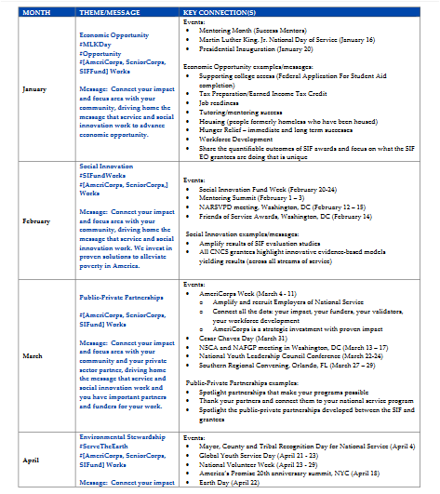
2017 Engagement Plan
Monthly Themes:
March: Public-Private Partnerships Month
June: Healthy Futures (Hunger) Month
August: Education Month
September: Disaster Services Month
October: Volunteer Mobilization Month
December: Giving Back
Notes:
Download at: https://www.nationalservice.gov/sites/default/files/documents/CNCS_2017_Public_Engagement_Plan_and_Calendar_FINAL.pdf
Goal of this Guide: To inspire Americans to increase their knowledge, awareness, and support of national service and social
innovation as the country’s best investment in community-led problem solving, civic engagement, and collaboration.
Objectives:
Amplify the impact of AmeriCorps, Senior Corps, the Social Innovation Fund, and the Volunteer Generation Fund as cost effective and evidence-based investments to improve communities and provide opportunities for Americans to make their communities stronger and thereby increasing impact and participation.
Partner with AmeriCorps and Social Innovation Fund grantees on promoting evaluations of their evidence based practices and program impact.
Partner with Senior Corps on promoting the evaluations of the Foster Grandparents, Senior Companions, and RSVP programs.
Partner with the Social Innovation Fund on promoting its projects, evaluation reports, and impact via its grantees.
Leverage amplification of best practices and programmatic impact to increase partnerships and resources to expand national service and social innovation investments and impact.
Strengthen ties with established supporters of national service, social innovation and performance-based outcomes to reinforce and expand the tradition of bipartisan investment in national service.
Demonstrate the value of AmeriCorps, Senior Corps, and the Social Innovation Fund by using the identified program weeks as opportunities to educate the public about program impact, sharing solutions to national and local challenges, and engaging more participants to make our communities stronger and healthier.
Increase visibility of Governor-appointed State Service Commissions and state funded programs.

Slide 26
2017 Engagement Plan
Regional Events and Collaborations
+ Other Advocacy Efforts, Days of Service and More!
Notes:
We know this is a lot to ask, but…

Slide 27
Regional Events + Collaborations
Why Regional Focus?
Texas is a huge state
Central Texas
North Texas
South Texas
West Texas
East Texas
Our portfolio is 3-4x the size of most states
Strong cross-stream relationships between State/National, VISTA, NCCC, Alum Chapters, and Senior Corps)

Slide 28
Questions?
Emily Steinberg
Director of National Service Programs
emily@onestarfoundation.org
(512) 287-2008

Slide 29
JUST REMEMBER…

